Slide 1
WORKSHOP ON STATISTICS 15-16 OCT 2016

Slide 2
FOUNDATIONS OF PROBABILITY
BHAVYA H
STATISTICS PROFESSIONAL
SPOCTEC TECHNOLOGICAL AND RESEARCH CENTRE

Slide 3
Probability Theory

Slide 4
Basic terminologies
Random phenomena
Unable to predict the outcomes, but in the long-run, the outcomes exhibit statistical regularity.
Examples
Tossing a coin – outcomes S ={Head, Tail}
Unable to predict on each toss whether is Head or Tail.
In the long run can predict that 50% of the time heads will occur and 50% of the time tails will occur

Slide 5
The sample Space, S
The sample space, S, for a random phenomena is the set of all possible outcomes.

Slide 6
Examples
Tossing a coin – outcomes S ={Head, Tail}
Rolling a die – outcomes
S ={ , , , , , }
={1, 2, 3, 4, 5, 6}

Slide 7
An Event , E
The event, E, is any subset of the sample space, S. i.e. any set of outcomes (not necessarily all outcomes) of the random phenomena
S
E

Slide 8
Examples
Rolling a die – outcomes
S ={ , , , , , }
={1, 2, 3, 4, 5, 6}
E = the event that an even number is rolled
= {2, 4, 6}
={ , , }

Slide 9
Mutually exclusive
Two events A and B are called mutually exclusive if:
A
B

Slide 10
Independent Events
The occurrence of one event in no way influences the probability of the occurrence of the other event.
Dependent Events
The occurrence of one event impacts the probability of the other event occurring.
Exhaustive events
The total number of possible outcomes of a random experiment.
Equally likely
Taking into consideration all the relevant evidences, there is no reason to expect one in preference to the others.

Slide 11
Assigning Probabilities
Three approaches to assigning probabilities
Classical
Empirical (i.e., relative frequency)
Subjective (based on whatever information is available)

Slide 12
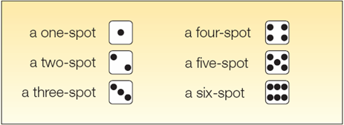
Classical Probability
Consider an experiment of rolling a six-sided die. What is the probability of the event “an even number of spots appear face up”?
The possible outcomes are:
There are three “favorable” outcomes (a two, a four, and a six) in the collection of six equally likely possible outcomes.

Slide 13
Empirical Probability
The empirical approach to probability is based on what is called the law of large numbers. The key to establishing probabilities empirically is that more observations will provide a more accurate estimate of the probability.

Slide 14

Subjective Probability
If there is little or no past experience or information on which to base a probability, it may be arrived at subjectively.
Illustrations of subjective probability are:
Estimating the likelihood you will be married before the age of 30.
Estimating the likelihood the Indian budget deficit will be reduced by half in the next 10 years.

Slide 15
Rules of Probability

Slide 16
The additive rule (Mutually exclusive events)
P[A ∪ B] = P[A] + P[B]
i.e.
P[A or B] = P[A] + P[B]
if A ∩ B = φ
(A and B mutually exclusive)

Slide 17
The additive rule
(In general)
P[A ∪ B] = P[A] + P[B] – P[A ∩ B]
or
P[A or B] = P[A] + P[B] – P[A and B]

Slide 18
Logic
When P[A] is added to P[B] the outcome in A ∩ B are counted twice
hence
P[A ∪ B] = P[A] + P[B] – P[A ∩ B]

Slide 19
Example: Bangalore and Dharwad are two of the cities competing for the National university games. (There are also many others). The organizers are narrowing the competition to the final 5 cities. There is a 20% chance that Bangalore will be amongst the final 5. There is a 35% chance that Dharwad will be amongst the final 5 and an 8% chance that both Bangalore and Dharwad will be amongst the final 5. What is the probability that Bangalore or Dharwad will be amongst the final 5.

Slide 20
Solution: Let A = the event that Bangalore is amongst the final 5. Let B = the event that Dharwad is amongst the final 5. Given P[A] = 0.20, P[B] = 0.35, and P[A ∩ B] = 0.08 What is P[A ∪ B]? Note: “and” ≡ ∩, “or” ≡ ∪ .

Slide 21
Rule for complements
or

Slide 22
Logic:
A

Slide 23
Joint Probability
For events A and B, joint probability Pr(AB) stands for the probability that both events happen.

Slide 24
Conditional Probability
Suppose that we are interested in computing the probability of event A and we have been told event B has occurred.
Then the conditional probability of A given B is defined to be:

Slide 25
Rationale:
If we’re told that event B has occurred then the sample space is restricted to B.
The event A can now only occur if the outcome is in of A ∩ B.
The probability within B has to be normalized. This is achieved by dividing by P[B]
Hence the new probability of A is:
A
B
A ∩ B

Slide 26
An Example
The academy awards is soon to be shown.
For a specific married couple the probability that the husband watches the show is 80%, the probability that his wife watches the show is 65%, while the probability that they both watch the show is 60%.
If the husband is watching the show, what is the probability that his wife is also watching the show.

Slide 27
Solution:
Let B = the event that the husband watches the show
P[B]= 0.80
Let A = the event that his wife watches the show
P[A]= 0.65 and P[A ∩ B]= 0.60

Slide 28
Independence
Two events A and B are called independent if

Slide 29
Note
Thus in the case of independence the conditional probability of an event is not affected by the knowledge of the other event

Slide 30
Difference between independence and mutually exclusive
Mutually Exclusive
Two mutually exclusive events are independent only in the special case where
Mutually exclusive events are highly dependent. A and B cannot occur simultaneously. If one event occurs the other event does not occur.
A
B

Slide 31
The multiplicative rule of probability
and
if A and B are independent.

Slide 32
Summary of the Rules of Probability

Slide 33
The additive rule
P[A ∪ B] = P[A] + P[B] – P[A ∩ B]
and
if P[A ∩ B] = φ
P[A ∪ B] = P[A] + P[B]

Slide 34
The Rule for complements
for any event E

Slide 35
Conditional probability

Slide 36
The multiplicative rule of probability
and
if A and B are independent.
This is the definition of independent

Slide 37
BAYES THEOREM

Slide 38
Probability Revision using Bayes’ Theorem
Prior
Probabilities
New
Information
Application of
Bayes’
Theorem
Posterior
Probabilities

Slide 39
Definitions
Prior probability - the probability of an event before new information (finding) is acquired; pretest probability or risk
Posterior probability - the probability of an event after new information (finding) is acquired; posttest probability or risk
Probability revision - taking new information into account by converting prior probability to posterior probability

Slide 40
Bayes' Theorem
If are mutually disjoint events with then for any arbitrary event A which is a subset of such that
, we have

Slide 41
A Simple Example
Mode of transport: Probability he is late:
Car 50%
Bus 20%
Train 1%
Suppose that Raju is late one day.
His boss wishes to estimate the probability that he traveled to work that day by car.
He does not know which mode of transportation Raju usually uses, so he gives a prior probability of 1 in 3 to each of the three possibilities.

Slide 42
P(A|B) = P(B|A) P(A) / P(B)
P(car|late) = (P(late|car) x P(car)) / P(late)
P(late|car) = 0.5 (he will be late half the time he drives)
P(car) = 0.33 (this is the boss' assumption)
P(late) = 0.5 x 0.33 + 0.2 x 0.33 + 0.01 x 0.33
(all the probabilities that he will be late added together)
P(car|late) = (0.5 x 0.33) / (0.5 x 0.33 + 0.2 x 0.33 + 0.01 x 0.33)
= 0.165 / 0.2343
= 0.7042

Slide 43
Random Variables and Distributions

Slide 44
Random Variable and Distribution
A random variable X is a numerical outcome of a random experiment
The distribution of a random variable is the collection of possible outcomes along with their probabilities:
Discrete case:
Continuous case:

Slide 45
Random Variable: Example
For example, if you roll a die, the outcome is random (not fixed) and there are 6 possible outcomes, each of which occur with probability one-sixth.

Slide 46
Random variables can be discrete or continuous
Discrete random variables have a countable number of outcomes
Examples: dice, counts, etc.
Continuous random variables have an infinite continuum of possible values.
Examples: blood pressure, weight, the speed of a car, the real numbers from 1 to 6.

Slide 47
Probability functions
A probability function maps the possible values of x against their respective probabilities of occurrence, p(x)
P(x) is a number from 0 to 1.0.
Notes:
It turns out that if you were to go out and sample many, many times, most sample statistics that you could calculate would follow a normal distribution.
What are the 2 parameters (from last time) that define any normal distribution?
Remember that a normal curve is characterized by two parameters, a mean and a variability (SD)
What do you think the mean value of a sample statistic would be? The standard deviation?
Remember standard deviation is natural variability of the population
Standard error can be standard error of the mean or standard error of the odds ratio or standard error of the difference of 2 means, etc. The standard error of any sample statistic.

Slide 48
The probability function that accompanies a discrete random variable is a discrete probability function that sums to 1 and called as Probability Mass Function.
The probability function that accompanies a continuous random variable is a continuous probability function that integrates to 1 and called as Probability Density Function.

Slide 49
Discrete example: roll of a die
p(x)
1/6
x
1
2
3
4
5
6

Slide 50
Probability mass function (pmf)
x
p(X=x)
1
p(X=1)=1/6
2
p(X=2)=1/6
3
p(X=3)=1/6
4
p(X=4)=1/6
5
p(X=5)=1/6
6
p(X=6)=1/6
1.0

Slide 51
Cumulative distribution function
x
P(X≤x)
1
P(X≤1)=1/6
2
P(X≤2)=2/6
3
P(X≤3)=3/6
4
P(X≤4)=4/6
5
P(X≤5)=5/6
6
P(X≤6)=6/6

Slide 52
Cumulative distribution function (CDF)
1.0
P(x)
5/6
2/3
1/2
1/3
1/6
1
2
3
4
5
6
x

Slide 53
Expected Value and Variance
All probability distributions are characterized by an expected value (mean) and a variance (standard deviation squared).

Slide 54
Expected value of a random variable
Expected value is just the average or mean (µ) of random variable X.
It’s sometimes called a “weighted average” because more frequent values of X are weighted more highly in the average.
It’s also how we expect X to behave on-average over the long run (“frequentist” view again).

Slide 55
Expected value
Discrete case:
Continuous case:

Slide 56
Example: the lottery
The Lottery (also known as a tax on people who are bad at math…)
A certain lottery works by picking 6 numbers from 1 to 49. It costs Rs.1.00 to play the lottery, and if you win, you win Rs.20 lakh after taxes.
If you play the lottery once, what are your expected gains or losses?

Slide 57
Lottery
Calculate the probability of winning in 1 try:
“49 choose 6”
Out of 49 numbers, this is the number of distinct combinations of 6.
The probability function (note, sums to 1.0):
Rs.x
p(x)
-1
.999999928
+ 20 lakh
7.2 x 10⁻⁸

Slide 58
Expected Value
The probability function
Rs. x
p(x)
-1
.999999928
+ 20 lakh
7.2 x 10⁻⁻⁸
Expected Value
E(X) = P(win)*(20,00,000) + P(lose)*(-1.00)
= 2.0 x 10⁶ * 7.2 x 10⁻⁸+ .999999928 (-1) = .144 - .999999928 = -0.86
Negative expected value is never good!
You shouldn’t play if you expect to lose money!

Slide 59
Variance/standard deviation
σ²=Var(X) =E(X-μ)²
“The expected (or average) squared distance (or deviation) from the mean”

Slide 60
Variance
Discrete case:
Continuous case:

Slide 61
Moments of probability distributions
The moments of a probability distribution are a way of characterising its position and shape.

Slide 62
Central (or Mean) Moments
The average of all the deviations of all observations in a dataset from the mean of the observations raised to the power r.

Slide 63
The r^{th} central moment of X
where μ = E(X) = the first moment of X about zero.

Slide 64
There are 4 important central moments:
The first central moment, r=1, is the sum of the difference of each observation from the sample average (arithmetic mean), which always equals 0
The second central moment, r=2, is variance.

Slide 65
The third central moment, r=3, gives skewness.
Skewness describes how the sample differs in shape from a symmetrical distribution.
The skewness is measured using the moments ratio
For symmetric distributions it is zero and has positive value for positively skewed distributions and takes negative value for negatively skewed distributions

Slide 66
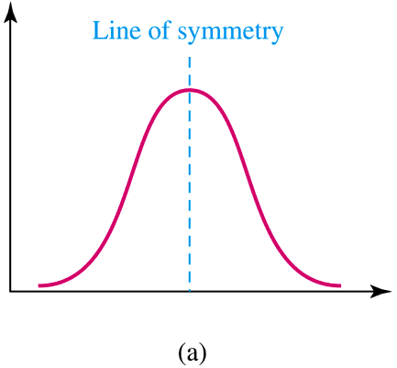
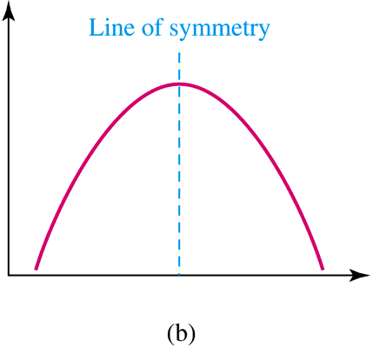
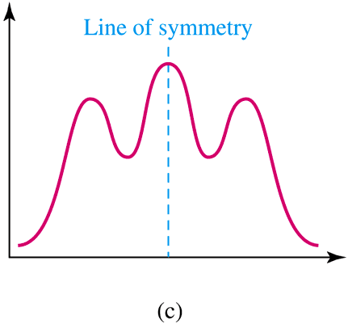
Symmetry or Skewness
A distribution is symmetric if its left half is a mirror image of its right half.
A symmetric distribution with a single peak and a bell shape is known as a normal distribution.

Slide 67
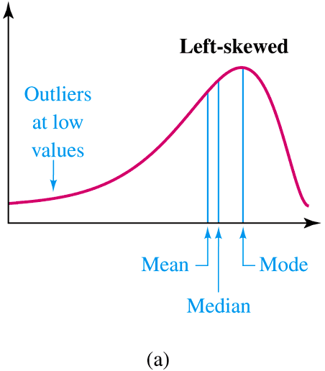
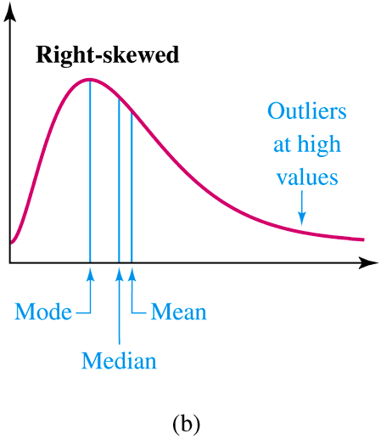
Symmetry or Skewness
A distribution is left-skewed
(or negatively skewed) if the values
are more spread out on the left,
meaning that some low values are
likely to be outliers.
A distribution is right skewed
or positively skewed if the
values are more spread out
on the right. It has a tail
pulled toward the right.

Slide 68
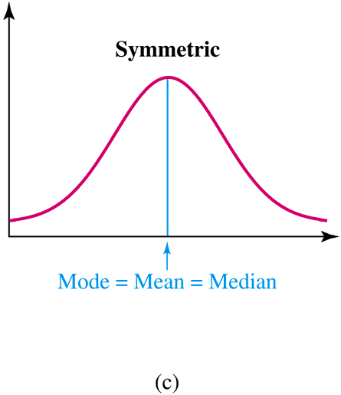

Slide 69
In a negatively(left) skewed distribution, the
mode > median > mean.

Slide 70
In a negatively(right) skewed distribution, the
mode < median < mean.

Slide 71
The 4th central moment measures kurtosis.
This is the “peakedness” of a distribution.
It measures the extent to which the data are distributed in the tails versus the center of the distribution

Slide 72
There are three types of peakedness.
Leptokurtic- very peaked
Platykurtic – relatively flat
Mesokurtic – in between

Slide 73
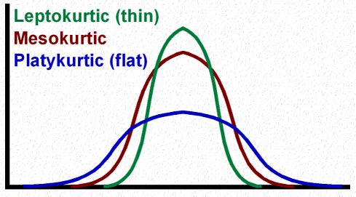
For a normal distribution, kurtosis is equal to 3.
When it is greater than 3, the curve is more sharply peaked and has narrower tails than the normal curve and is said to be leptokurtic.
When it is less than 3, the curve has a flatter top and relatively wider tails than the normal curve and is said to be platykurtic.

Slide 74
The r^{th} moment of X about zero.

Slide 75
Relation between Moments about Mean and Moments about Origin

Slide 76
Moment generating functions

Slide 77
Moment Generating function of a R.V. X

Slide 78
Properties of Moment Generating Functions

Slide 79
m_{X}(0) = 1
Example

Slide 80
We use the expansion of the exponential function:

Slide 81
Now

Slide 82
Property 3 is very useful in determining the moments of a random variable X.
Examples

Slide 83
Let X be a random variable with moment generating function m_{X}(t). Let Y = bX + a
Then m_{Y}(t) = m_{bX + a}(t)
= E(e ^{[bX + a]t}) = e^{at}m_{X} (bt)
Let X and Y be two independent random variables with moment generating function m_{X}(t) and m_{Y}(t) .
Then m_{X+Y}(t) = m_{X} (t) m_{Y} (t)

Slide 84
6. The moment generating function uniquely
determines the distribution. That is, if
then X and Y are identically distributed. This
means the two random variables must have
the same distribution.

Slide 85
PROBABILITY DISTRIBUTIONS

Slide 86
Binomial Probability Distribution
A fixed number of observations (trials), n
e.g., 15 tosses of a coin; 20 patients; 1000 people surveyed
A binary outcome
e.g., head or tail in each toss of a coin; disease or no disease
Generally called “success” and “failure”
Probability of success is p, probability of failure is 1 – p
Constant probability of success for each trial
e.g., Probability of getting a tail is the same each time we toss the coin

Slide 87
The trials of the experiment are independent of each other. This means that if one outcome is a success, this does not influence the chance of another outcome being a success.

Slide 88
The probability mass function of binomial distribution is
Where:
n is random sample size
x is number of successes ( when a success is defined as what we are looking for) and takes values x = 0, 1, …, n
n-x is number of failures.
p is probability of success.
is probability of failure

Slide 89



Mean and variance of a binomial distribution
If $X∼B(n,p)$,
$$μ=E\left(X\right)=np$$
$σ^{2}$ = var(X) = $np(1−p)$

Slide 90
Binomial distribution: example
If I toss a coin 20 times, what’s the probability of getting exactly 10 heads?

Slide 91
When there is a large number of trials, but a small probability of success, binomial calculation becomes impractical.
Example: Number of deaths from horse kicks in the Army in different years.

Slide 92
The Poisson Distribution
Poisson distribution is applied where random events in space or time are expected to occur.

Slide 93
Properties of the Poisson Distribution
It is used to count the number of occurrences of an event within a given unit of time, area, volume, etc.
The probability that an event will occur within a given unit must be the same for all units.
The occurrence or nonoccurrence of an event in one unit is independent of an occurrence or nonoccurrence of an event in any other unit.

Slide 94
The probability mass function of Poisson distribution is defined by:
Where:
x is the number of events occurring in a defined unit.
λ is the expected value or mean value of occurrences within an unit.
The parameter λ is both the mean and the variance of the Poisson distribution.

Slide 95
Example
For example, if new cases of Dengue in Kolkata are occurring at a rate of about 2 per month, then what are the probabilities that: 0,1, 2, 3, 4, 5, 6, to 1000 to 1 million to… cases will occur in Kolkata in the next month:

Slide 96
Poisson Probability table
X
P(X)
0
= 0.135
1
= 0.27
2
= 0.27
3
= 0.18
= 0.09
4
5
…
…

Slide 97
The Geometric Distribution
Suppose an experiment consists of a sequence of trials with the following conditions:
The trials are independent.
Each trial can result in one of two possible outcomes, success and failure.
The probability of success is the same for all trials.
A geometric random variable is defined as
x = number of trials until the first success is observed (including the success trial)

Slide 98
If x is a geometric random variable with probability of success p for each trial, then its probability mass function is

Slide 99
Example
A sharpshooter normally hits the target 70% of the time.
Find the probability that her first hit is on the second shot.

Slide 100
Normal Distributions
A random variable X with mean μ and standard deviation σ is normally distributed if its probability density function is given by
where

Slide 101
The Normal Distribution
f(x)
Changing μ shifts the distribution left or right.
Changing σ increases or decreases the spread.
σ
μ
X

Slide 102
PROPERTIES
It is unimodal; that is, the normal distribution peaks at a single value.
It is symmetric; this means that the two areas under the curve between the mean and any two points equidistant on either side of the mean are identical. One side of the distribution is the mirror image of the other side.
The mean, median, and mode are equal.
The tails of the normal curve approaches the horizontal axis on either side of the mean toward plus and minus infinity.
The amount of variation in the random variable determines the height and spread of the normal distribution.

Slide 103
The beauty of the normal curve:
No matter what μ and σ are,
The area between μ-σ and μ+σ is about 68%;
The area between μ-2σ and μ+2σ is about 95%; and
The area between μ-3σ and μ+3σ is about 99.7%. Almost all values fall within 3 standard deviations.

Slide 104
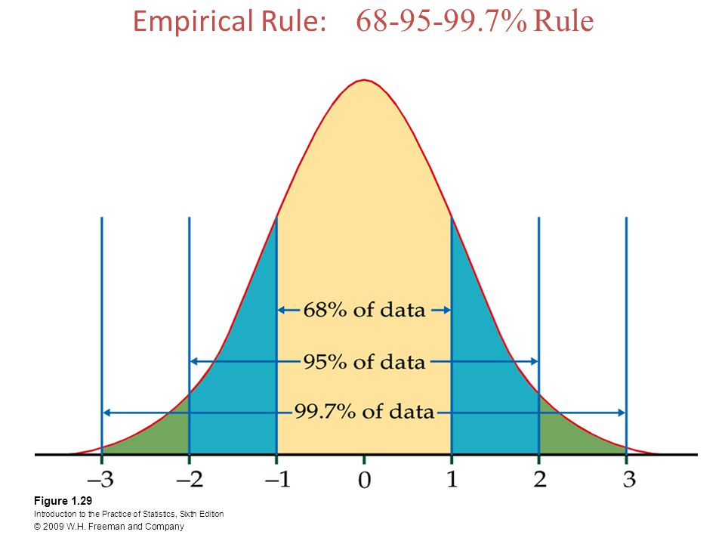

Slide 105
The Standard Normal Distribution (Z)
All normal distributions can be converted into the standard normal curve by subtracting the mean and dividing by the standard deviation:

Slide 106
The Standard Normal (Z):
The formula for the standardized normal probability density function is

Slide 107
Example - Adult Female Heights
What is the probability a randomly selected female is 5’10” or taller (70 inches)? Y ~ N(63.7 , 2.5)
Step 1 Y_{L} = 70.0 Y_{U} = ∞
Step 2
Step 3 P(Y ≥ 70) = P(Z ≥ 2.52) = .0059

Slide 108
Are my data normally distributed?
Look at the histogram! Does it appear bell shaped?
Compute descriptive summary measures—are mean, median, and mode similar?
Do 2/3 of observations lie within 1 std dev of the mean? Do 95% of observations lie within 2 std dev of the mean?
Look at a normal probability plot—is it approximately linear?

Slide 109
LAW OF LARGE NUMBERS

Slide 110
According to Law of Large Numbers, if X₁, X₂,…, Xn are independent random variables having a common distribution with mean μ, then for any number ε > 0, no matter how small, as n → ∞,

Slide 111
CENTRAL LIMIT THEOREM

Slide 112
Central Limit Theorem: For simple random samples of n observations taken from a population with mean μ and standard deviation σ, regardless of the population’s distribution, provided the sample size is sufficiently large, the distribution of the sample means, , will be approximately normal with a mean equal to the population mean ( ) and a standard deviation equal to the population standard deviation divided by the square root of the sample size
( ).

Slide 113
How Large is Large?
If the population is normal, then the sampling distribution of will also be normal, no matter what the sample size.
When the population is approximately symmetric, the distribution becomes approximately normal for relatively small values of n.
When the population is skewed, the sample size must be at least 30 before the sampling distribution of becomes approximately normal.

